Slide 1
Over watch Skill Analysis
The player with the higher numerical rating is expected to win. A player’s Expected Score can be calculated using the difference between the ratings of two players, which for our purposes can be considered the likelihood of winning.
After a game is completed, each player’s rating will be adjusted based on the outcome. The winner will take points from the loser, with no points being exchanged on a draw.
Typically matches last anywhere from 10–30 minutes

Slide 2
Features
team_1 : the average rating of the team
team_2 : the average rating of the enemy team
rating_diff : the difference between the two teams’ ratings [ team_2 - team_1]
result : the outcome of the match
A player’s skill can be inferred based on their wins, losses, draws and the relative skill of the opponents they play.

Slide 3
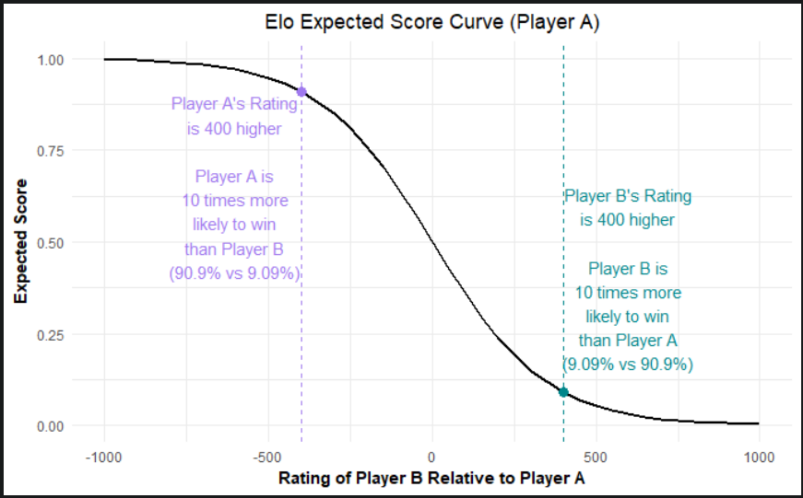
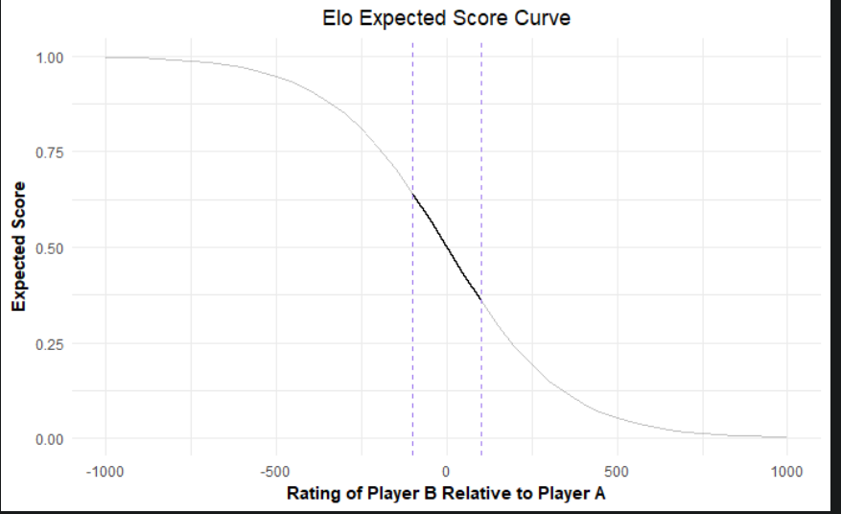
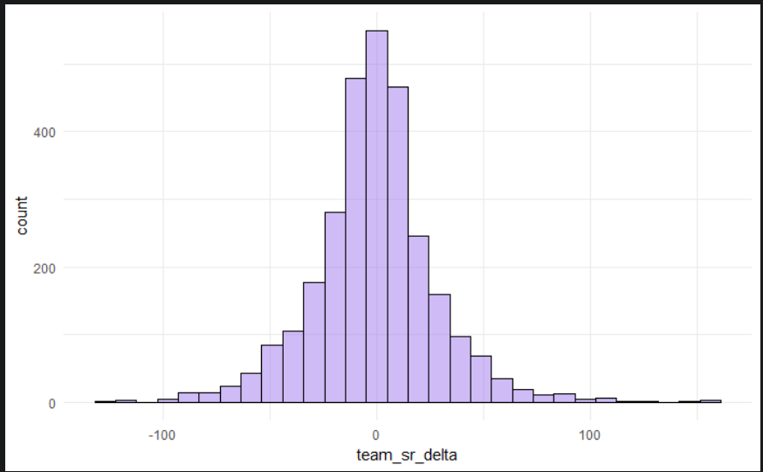
1. When the ratings of the two players are equal, the expected score for Player A is 50%.
2. When a player has a 400-point rating advantage over the other player, their expected score is 10 times larger than the other player’s.
3. In the range where most Competitive Overwatch matches are played (+/-100 Skill Rate) the Expected Score curve is nearly linear.
4. Differences between the team's ratings for each match appears to be normally distributed

